Slide 1
Outdoor Learning Group
Kyle Roberts, Peter Ferrante, Austin Pikulski, Jon Diaz

Slide 2
Our Mission
To Create a garden for kids to appreciate. And most of all, for them to learn how plants grow and live in our garden.

Slide 3
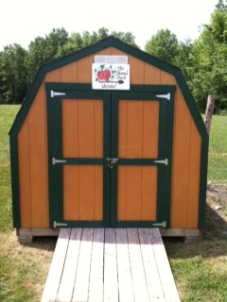

Slide 4
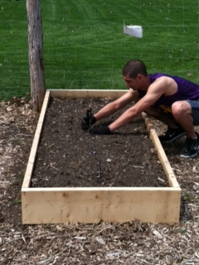

Slide 5
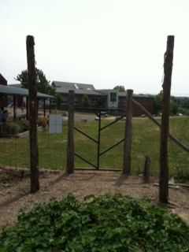

Slide 6
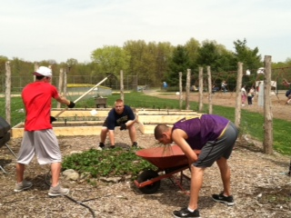

Slide 7
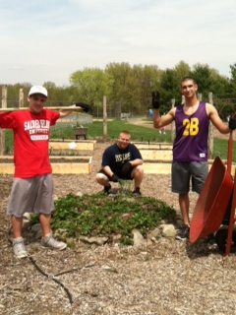

Slide 8
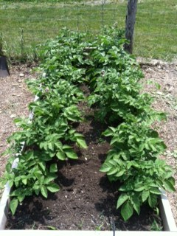

Slide 9
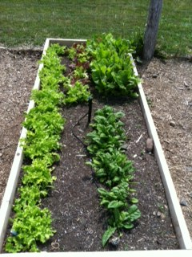

Slide 10
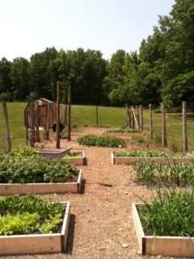

Slide 11
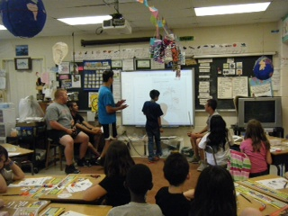

Slide 12
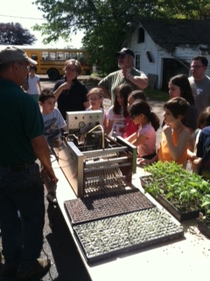

Slide 13
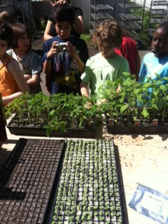

Slide 14
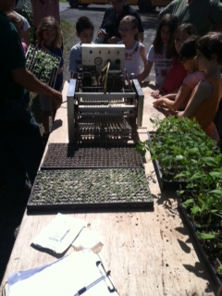

Slide 15
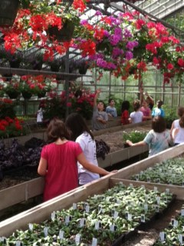

Slide 16
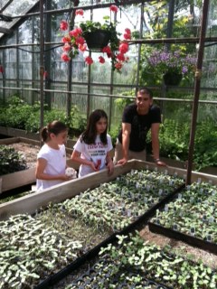

Slide 17
We would like to thank Mr.Dolan, Mr. Crocco, Mr.Orcutt, And Mr.Longbotham

