Slide 1
New Paltz Water Conservation Effort
Chris Perez, Thomas Covino, Kerry Shaw, Canaan Lightsey

Slide 2
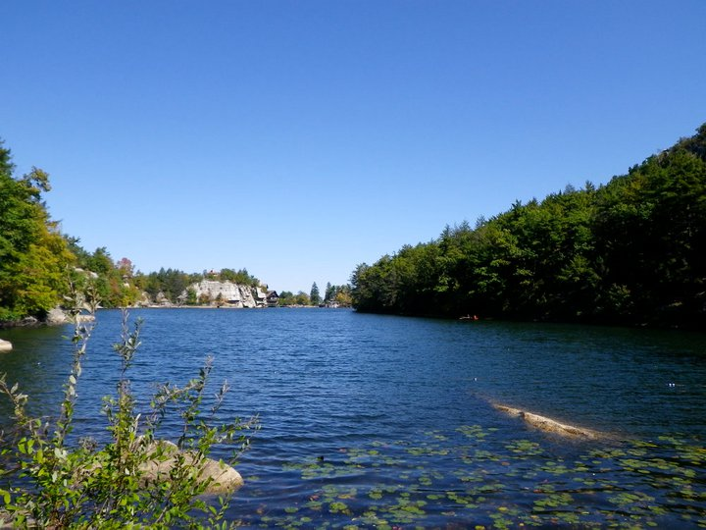
Lake Mohonk

Slide 3
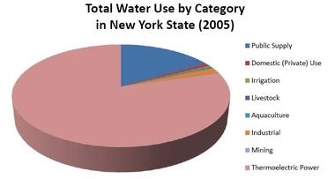
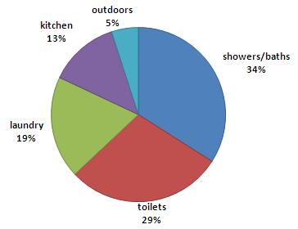

Slide 4
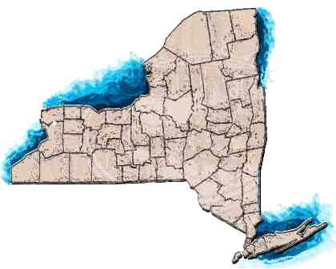
Who thinks twice about flushing the toilet?
-NY State population: Approx. 18,976,457
-1.5 Gallons per flush of an average modern toilet
If everyone in the state flushed the toilet 2 times
a day, 56,929,371 gallons of water
are used

Slide 5
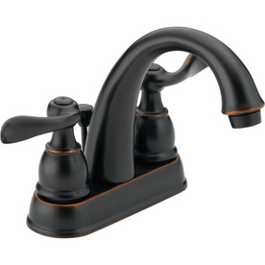
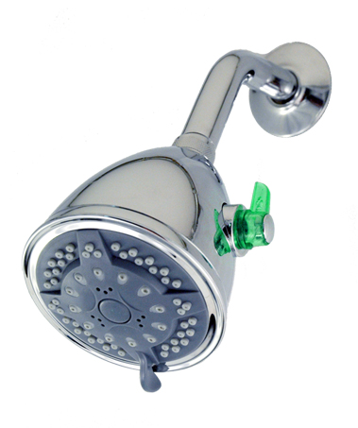
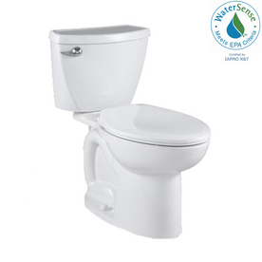
WaterSense products from Lowes.com

Slide 6
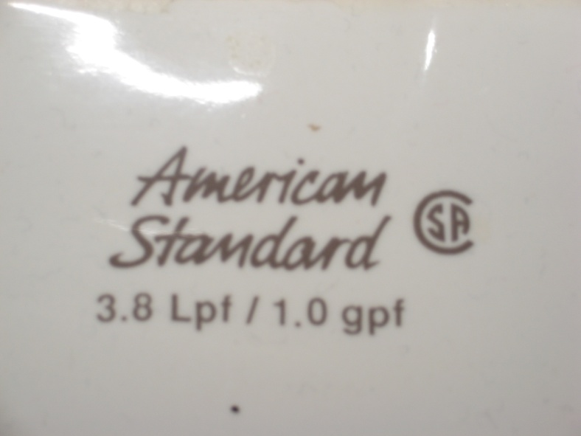
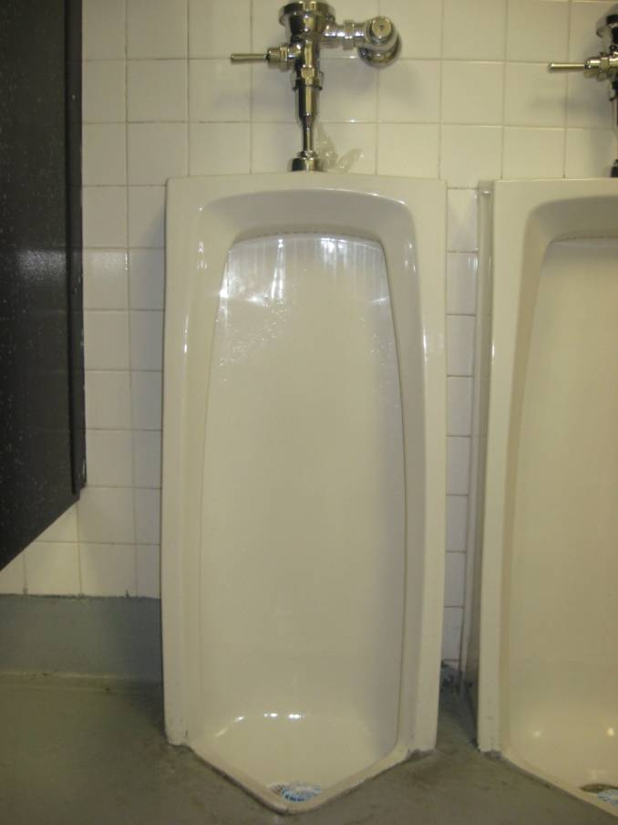
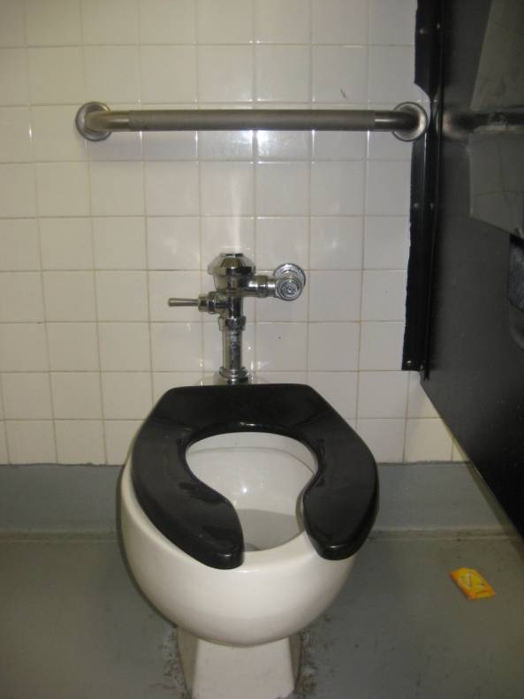
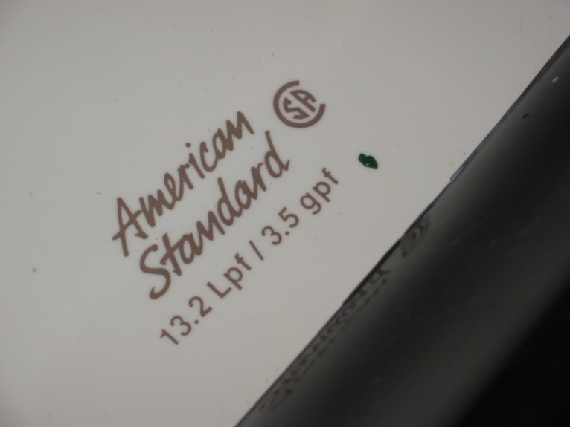
Current bathroom fixtures at New Paltz High School

Slide 7
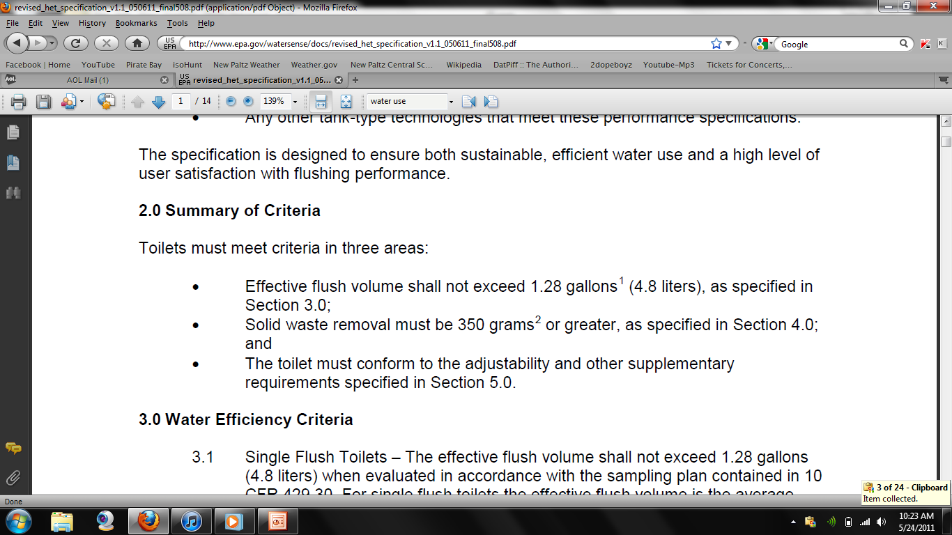
NPHS- 39 toilets total x 3.5 gallons per flush = 136.5 gallons if all toilets were flushed 1 times per day.
If WaterSense products were adopted:
39 toilets total x 1.28 gpf = 49.92 gallons
86.58 gallons of water can be saved per day

Slide 8
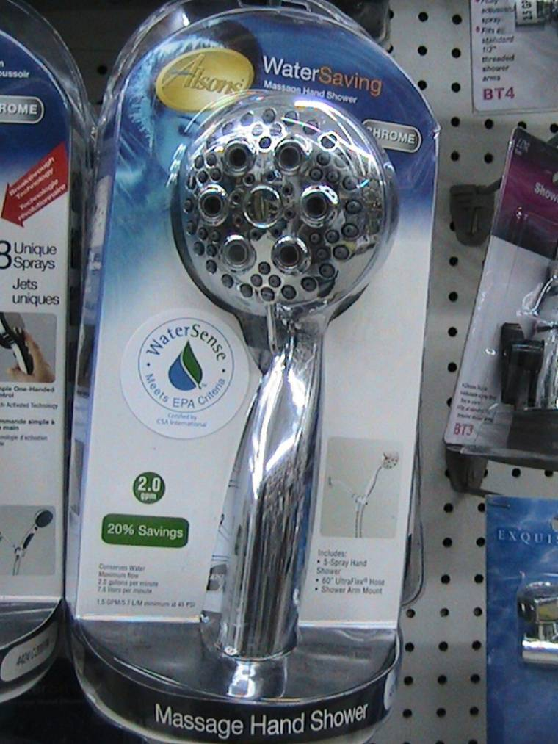
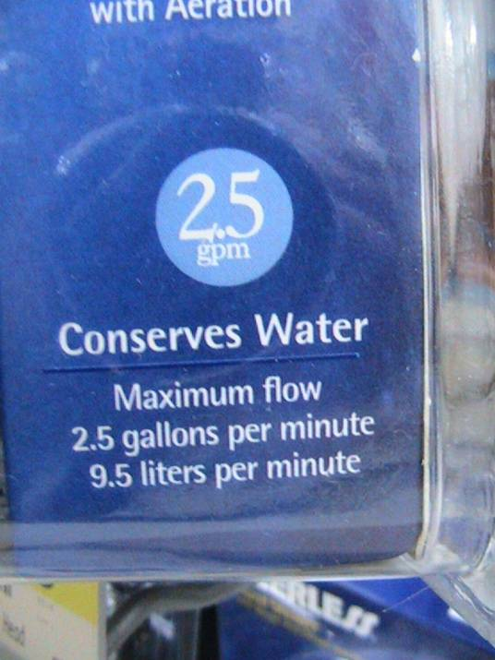
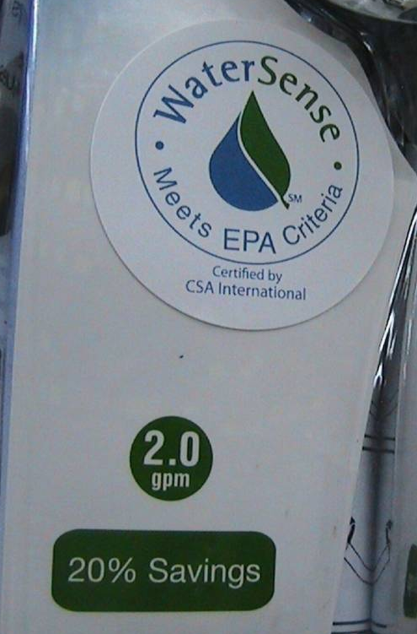
v.s

Slide 9
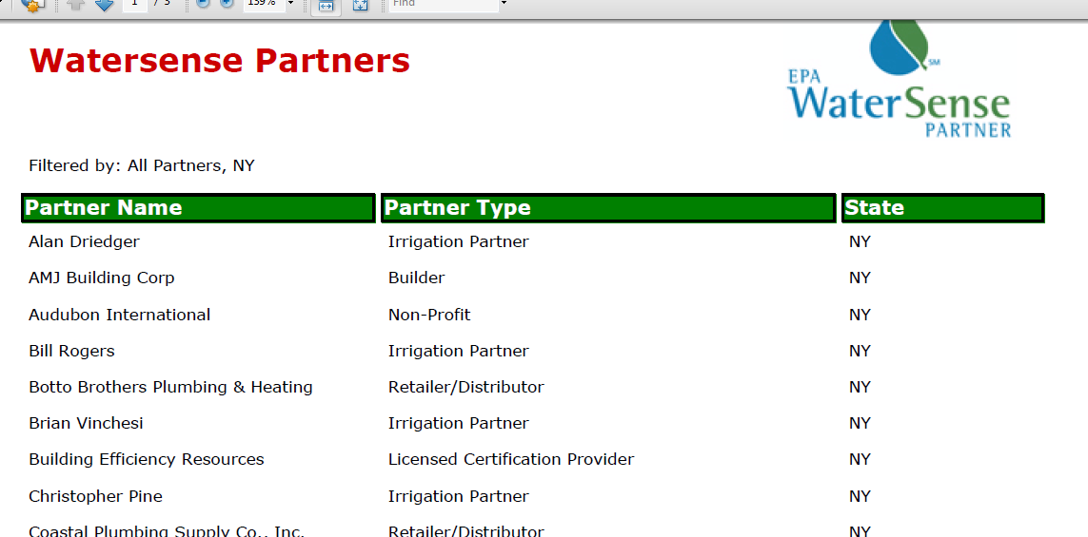

Slide 10
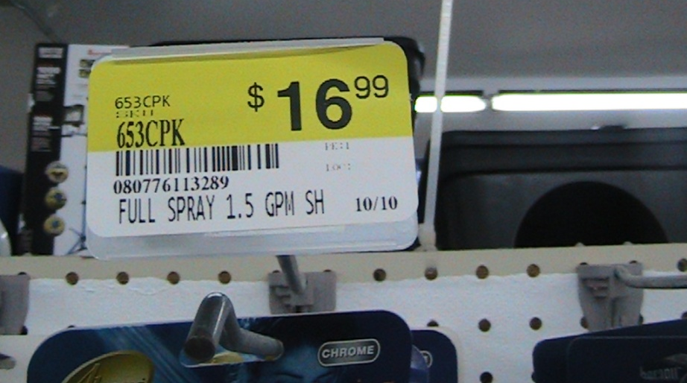
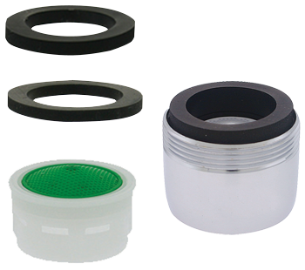
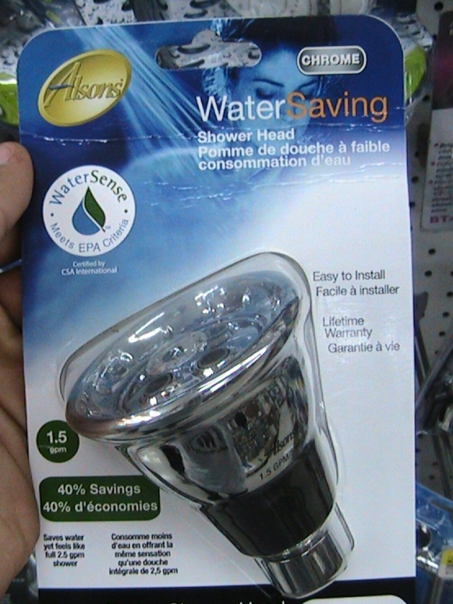
Going WaterSense does not have to destroy your pockets

Slide 11
FACT
If just one out of every 10 households in New York replaced its older, inefficient toilets with WaterSense labeled toilets, it would save nearly 8 billion gallons and more than $46 million in water bills annually.

